Slide 1


Slide 2
Machine Learning: Active Motion
Saura Elghonimi
Khushboo Agarwal
Eduardo Rivera

Slide 3
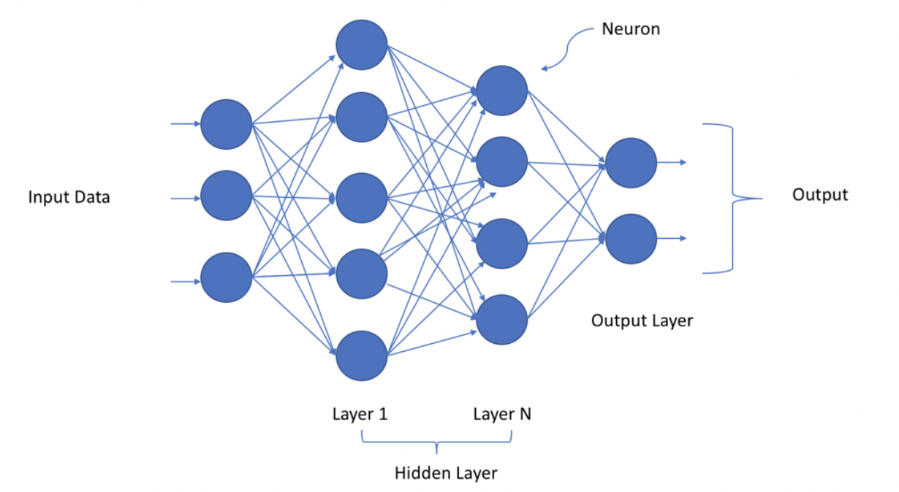
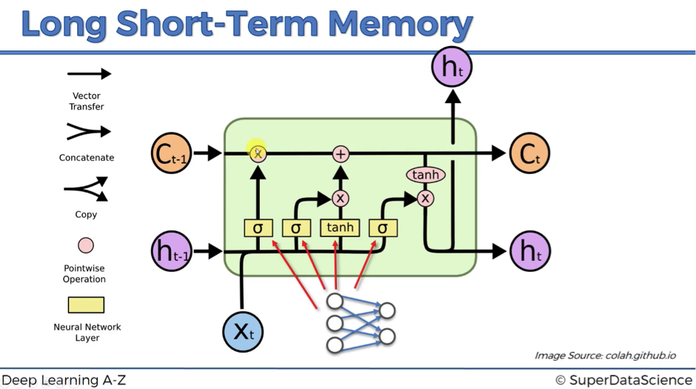
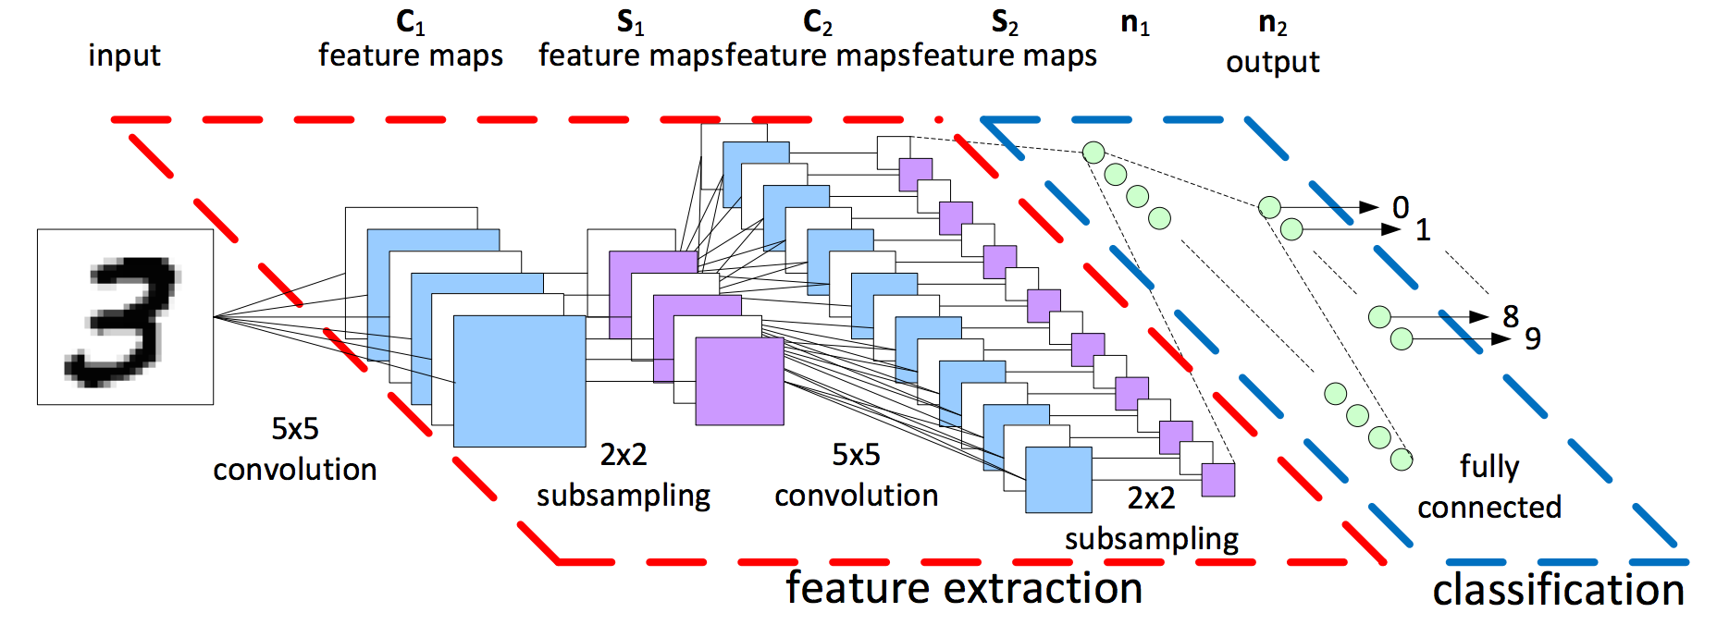
Supervised Learning Models used:
Deep Neural Network
Long Short-Term Memory
Feature Extraction CNN

Slide 4
Data Sources & Data Sets
Kaggle
Extra Sensory/Accelerometers
WISDM
Image data-sets with active actions
Stanford Action Dataset, provided data on certain actions into variables
Measured by high-frequency motion reactors in different wearable/mobile devices
Sensor data measured in tri-axial direction, acceleration, Lat. & Long., and audio magnitude before normalization
Actions include running, walking, jogging, upstairs, downstairs, sitting, standing full-stop

